Slide 1
Predicting Hypotensive Events with Transformer: A Comparative Performance Analysis
Group 20: 110550108 施柏江、110550068 王振倫、110550052 楊沁瑜

Slide 2
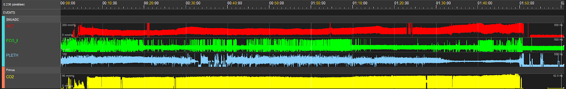
Introduction
Hypotensive Events Arterial pressure below 65 for one minute.
Input Signal
Arterial pressure
Electrocardiography (lead II)
Photoplethysmography
Capnography waveform

Slide 3
Task Types
Classification
Regression

Slide 4
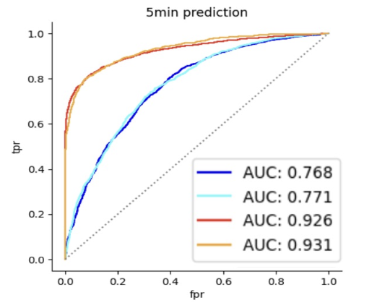
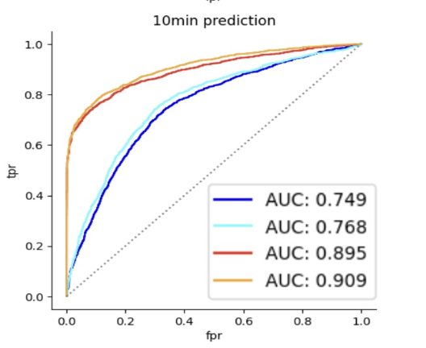
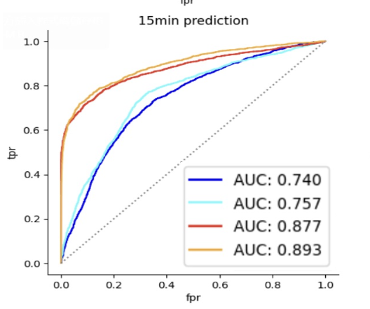
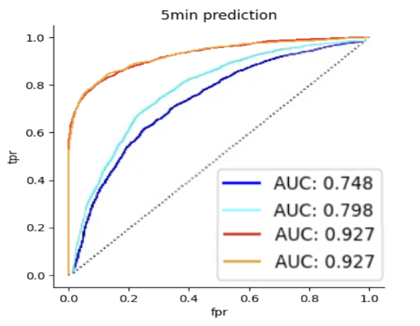
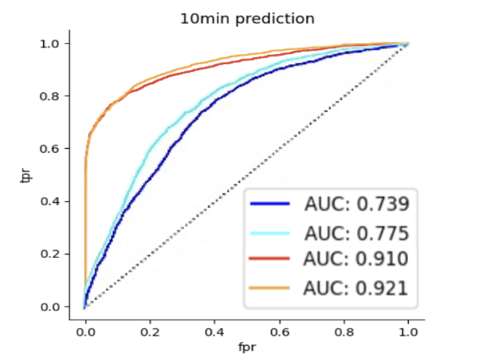
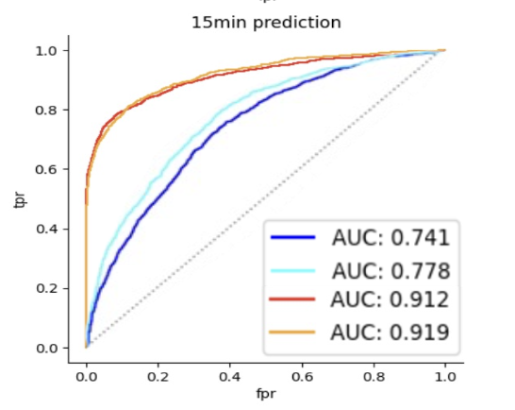
Previous Results of Classification Task
CNN
Transformer
Photoplethysmography-only input
Noninvasive multichannel input
Arterial-pressure-only input
Invasive multichannel input

Slide 5
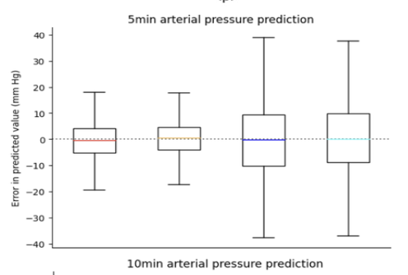
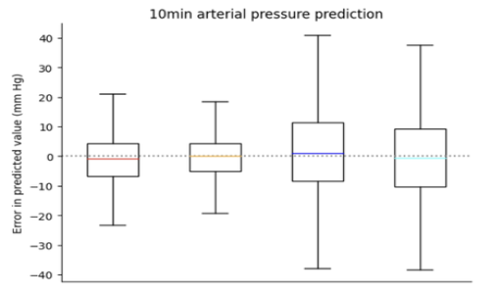
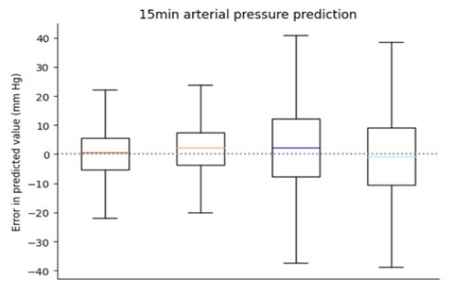
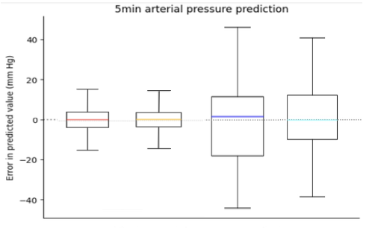
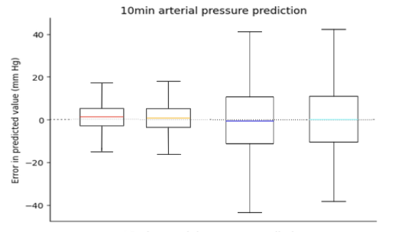
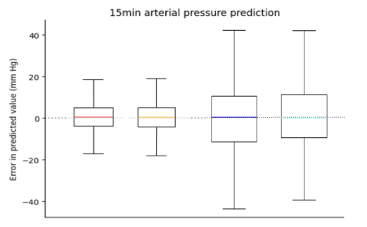
Previous Results of Regression Task
CNN
Transformer
Photoplethysmography-only input
Noninvasive multichannel input
Arterial-pressure-only input
Invasive multichannel input

Slide 6
Adjustments
Extended preprocessing time
Input: Noted as “Hypo”
N mins
30 sec
Hypotensive event
Optimization
Add dropout layers, setting some neurons' values to 0 to prevent overfitting
Data standardization
L2 normalization, add weight decay to loss function
Learning rate scheduling

Slide 7
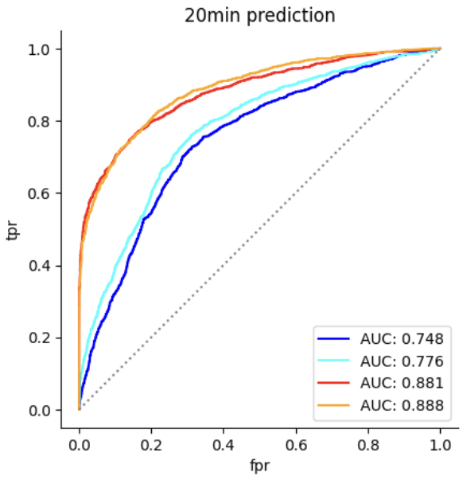
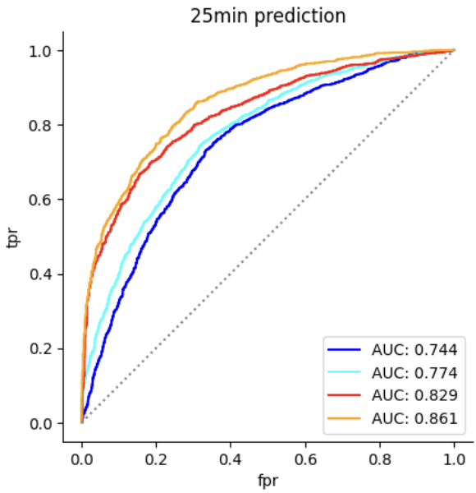
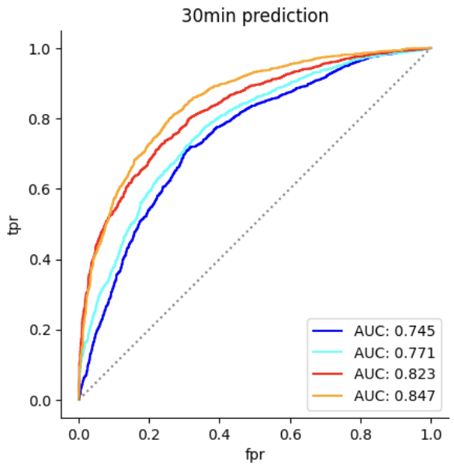
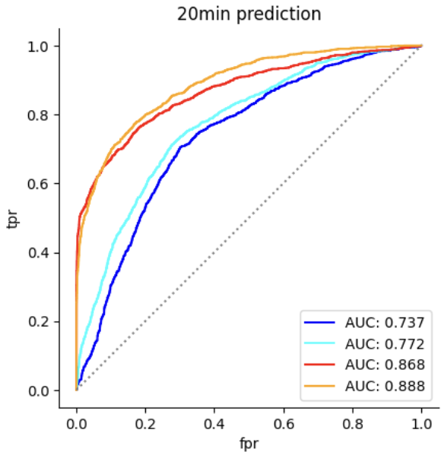
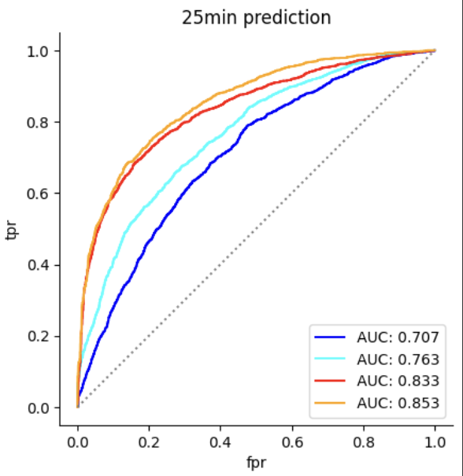
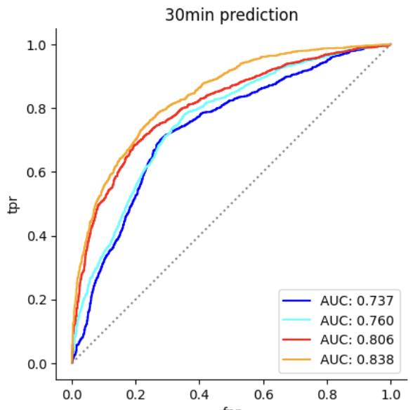
20, 25, 30min Results of Classification Task
CNN
Transformer
Photoplethysmography-only input
Noninvasive multichannel input
Arterial-pressure-only input
Invasive multichannel input

Slide 8
CNN
Transformer
20min | Accuracy | Sensitivity | Specificity | PPV | NPV
non | 0.72 | 0.54 | 0.81 | 0.63 | 0.76
non-multi | 0.73 | 0.64 | 0.77 | 0.62 | 0.80
invasive | 0.82 | 0.61 | 0.94 | 0.87 | 0.81
invasive-multi | 0.83 | 0.64 | 0.94 | 0.86 | 0.82
20min | Accuracy | Sensitivity | Specificity | PPV | NPV
non | 0.68 | 0.52 | 0.76 | 0.58 | 0.78
non-multi | 0.71 | 0.76 | 0.68 | 0.56 | 0.84
invasive | 0.82 | 0.69 | 0.90 | 0.78 | 0.85
invasive-multi | 0.83 | 0.73 | 0.89 | 0.77 | 0.86
25min | Accuracy | Sensitivity | Specificity | PPV | NPV
non | 0.71 | 0.57 | 0.77 | 0.58 | 0.78
non-multi | 0.73 | 0.48 | 0.86 | 0.66 | 0.76
invasive | 0.77 | 0.45 | 0.94 | 0.82 | 0.76
invasive-multi | 0.80 | 0.61 | 0.90 | 0.77 | 0.81
25min | Accuracy | Sensitivity | Specificity | PPV | NPV
non | 0.64 | 0.53 | 0.71 | 0.55 | 0.76
non-multi | 0.68 | 0.81 | 0.61 | 0.54 | 0.85
invasive | 0.75 | 0.52 | 0.87 | 0.77 | 0.78
invasive-multi | 0.78 | 0.79 | 0.77 | 0.66 | 0.87
30min | Accuracy | Sensitivity | Specificity | PPV | NPV
non | 0.70 | 0.37 | 0.85 | 0.59 | 0.75
non-multi | 0.72 | 0.49 | 0.83 | 0.59 | 0.77
invasive | 0.77 | 0.52 | 0.89 | 0.71 | 0.80
invasive-multi | 0.79 | 0.58 | 0.88 | 0.70 | 0.81
30min | Accuracy | Sensitivity | Specificity | PPV | NPV
non | 0.69 | 0.69 | 0.70 | 0.51 | 0.83
non-multi | 0.71 | 0.75 | 0.69 | 0.53 | 0.86
invasive | 0.76 | 0.71 | 0.78 | 0.60 | 0.86
invasive-multi | 0.78 | 0.79 | 0.77 | 0.61 | 0.89

Slide 9
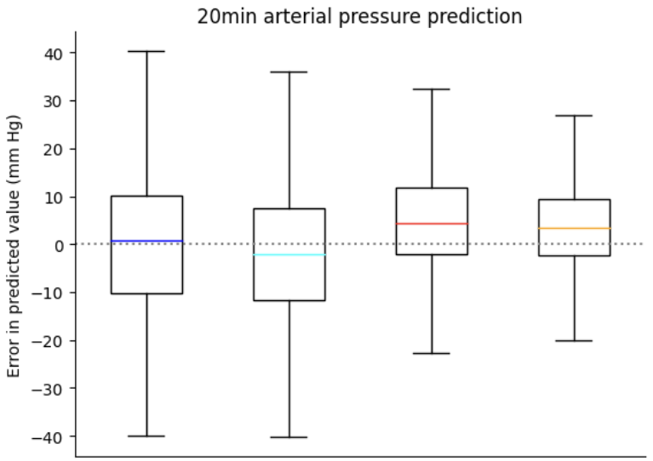
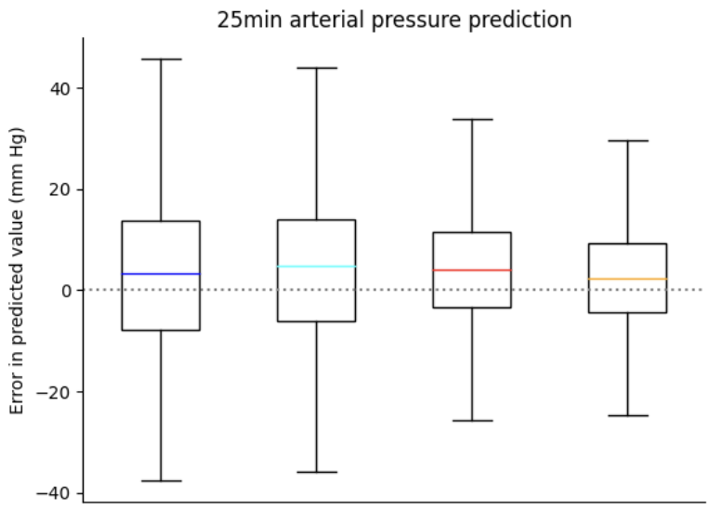
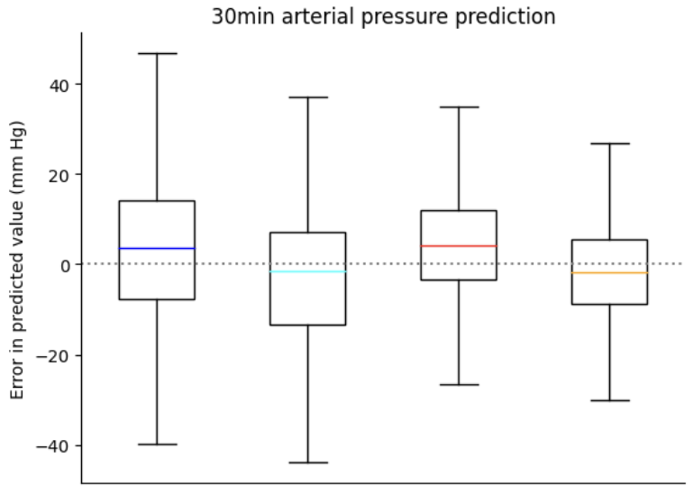
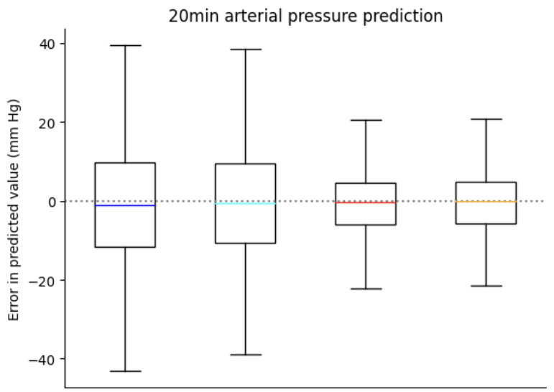
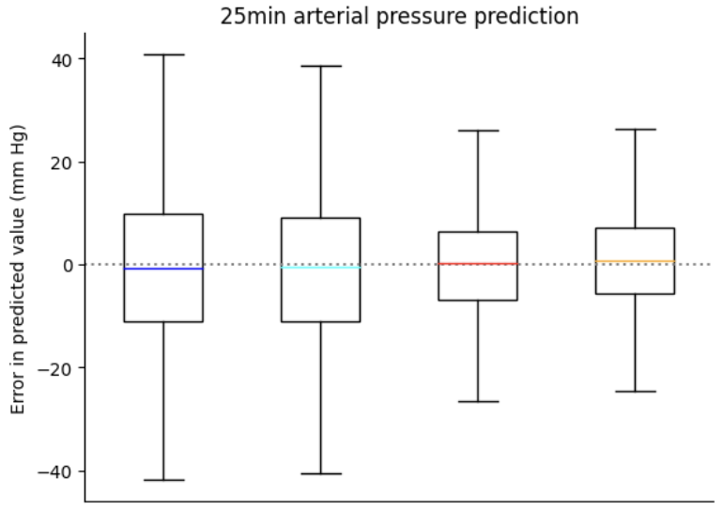
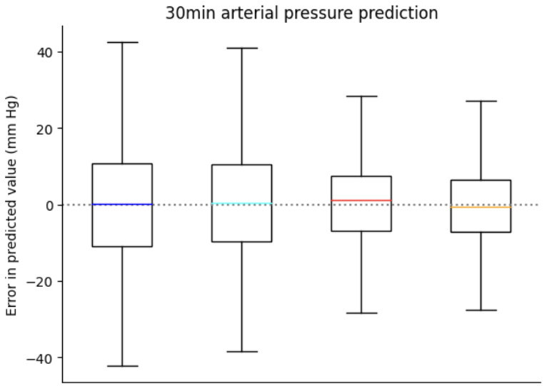
20, 25, 30min Results of Regression Task
CNN
Transformer
Photoplethysmography-only input
Noninvasive multichannel input
Arterial-pressure-only input
Invasive multichannel input

Slide 10
CNN
Transformer
20min | MAE | IQM
non | 11.91 | 10.65
non-multi | 11.50 | 10.05
invasive | 9.27 | 7.49
invasive-multi | 8.31 | 6.66
20min | MAE | IQM
non | 11.89 | 10.76
non-multi | 11.37 | 10.26
invasive | 8.04 | 5.97
invasive-multi | 7.75 | 5.90
25min | MAE | IQM
non | 12.23 | 10.81
non-multi | 11.82 | 10.66
invasive | 10.01 | 8.37
invasive-multi | 9.02 | 7.32
25min | MAE | IQM
non | 11.68 | 10.66
non-multi | 11.09 | 10.05
invasive | 9.02 | 7.15
invasive-multi | 8.47 | 6.75
30min | MAE | IQM
non | 12.29 | 11.04
non-multi | 11.75 | 10.45
invasive | 10.60 | 8.93
invasive-multi | 9.60 | 7.91
30min | MAE | IQM
non | 11.97 | 10.92
non-multi | 11.45 | 10.36
invasive | 9.49 | 7.66
invasive-multi | 8.99 | 7.33

Slide 11
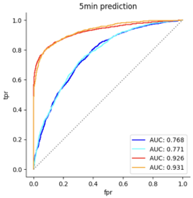
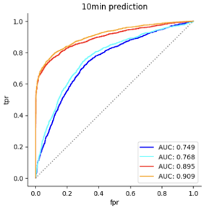
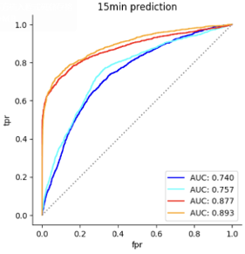
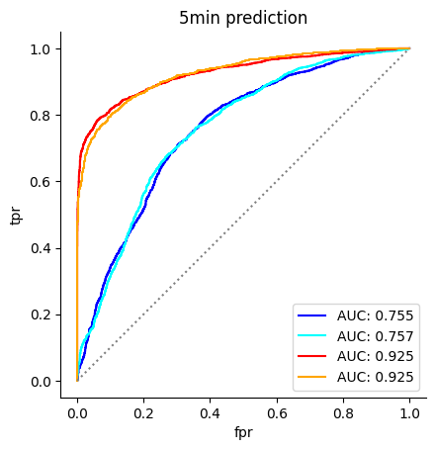
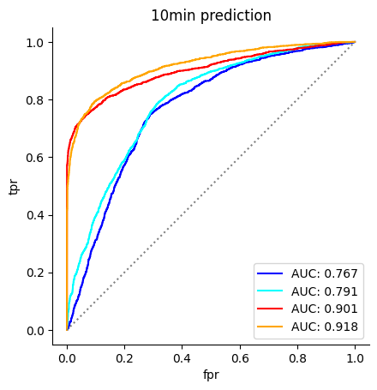
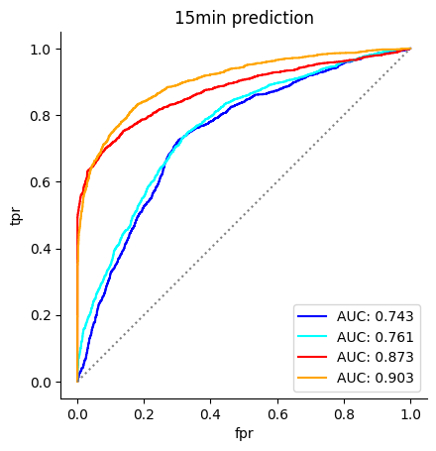
5, 10, 15min Results of Classification Task
CNN
Transformer
Photoplethysmography-only input
Noninvasive multichannel input
Arterial-pressure-only input
Invasive multichannel input

Slide 12
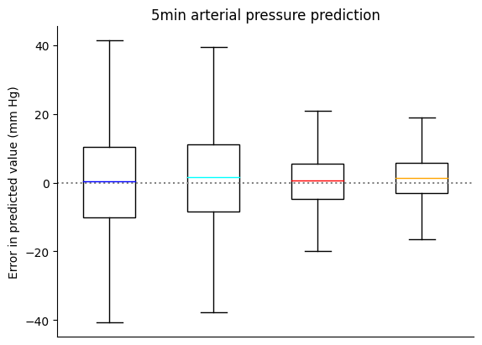
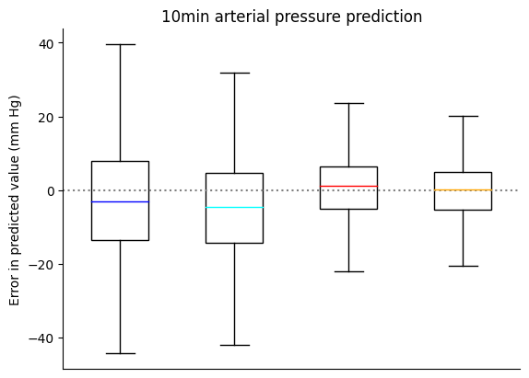
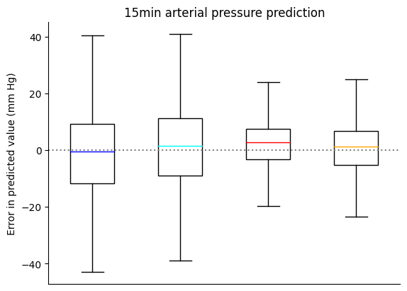
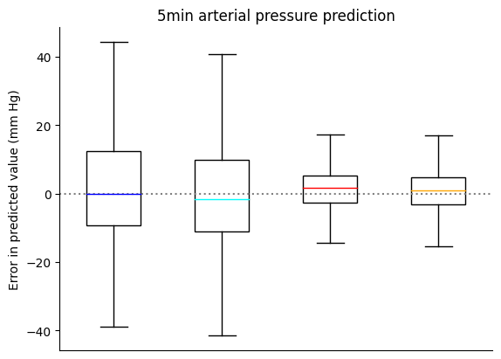
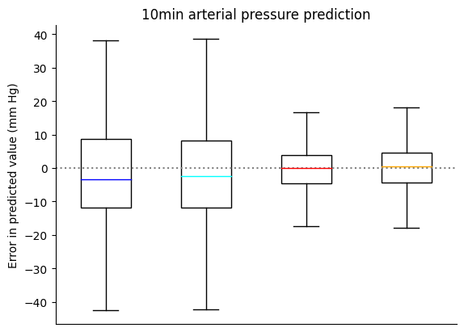
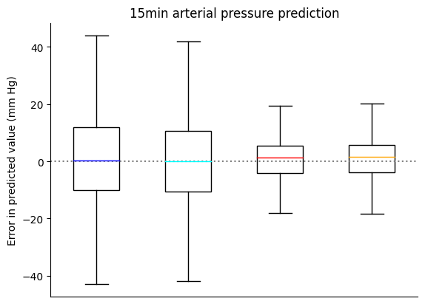
5, 10, 15min Results of Regression Task
CNN
Transformer
Photoplethysmography-only input
Noninvasive multichannel input
Arterial-pressure-only input
Invasive multichannel input

Slide 13
Discussion
Current difficulties:
Involves patient privacy
Conclusions:
Provided improved predictions at original 5, 10, and 15-minute intervals
Extended predictions for longer durations
Demonstrated strong performance in directly predicting blood pressure values

Slide 14
Thanks for Listening

